Slide 1
MongoDB Operators
161094 – Divansh Anupam

Slide 2
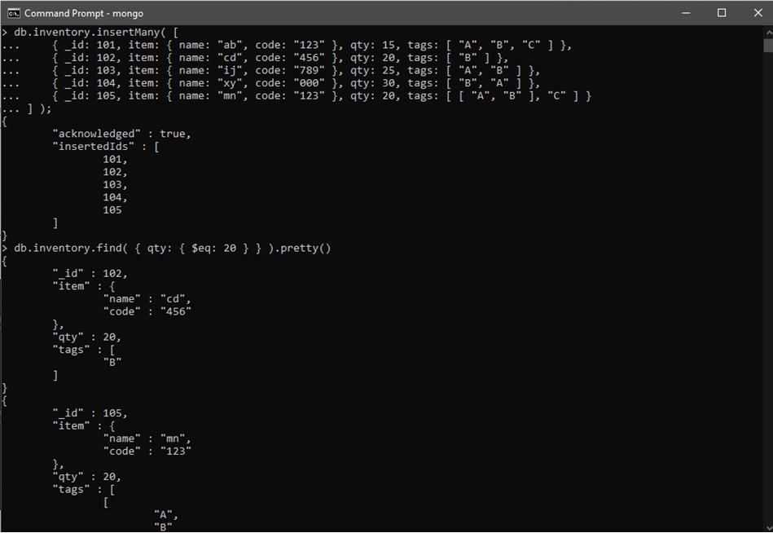
$eq operator

Slide 3
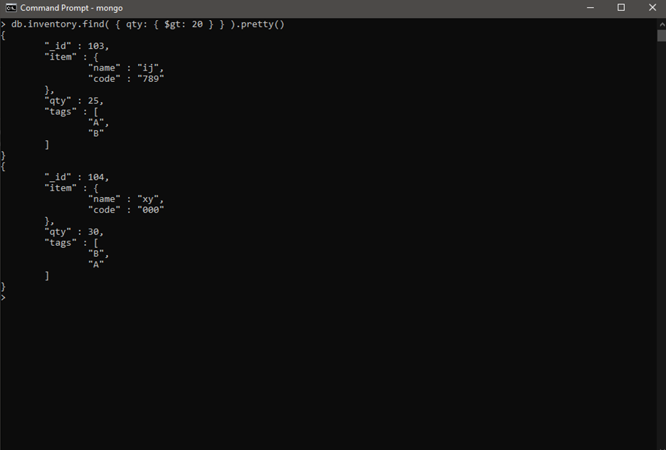
$gt operator

Slide 4
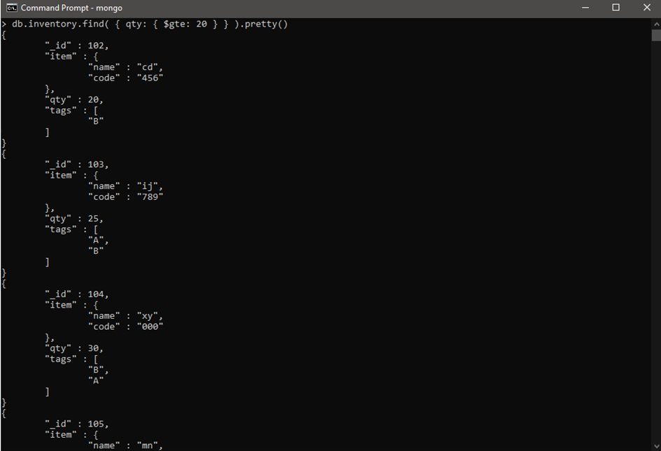
$gte operator

Slide 5
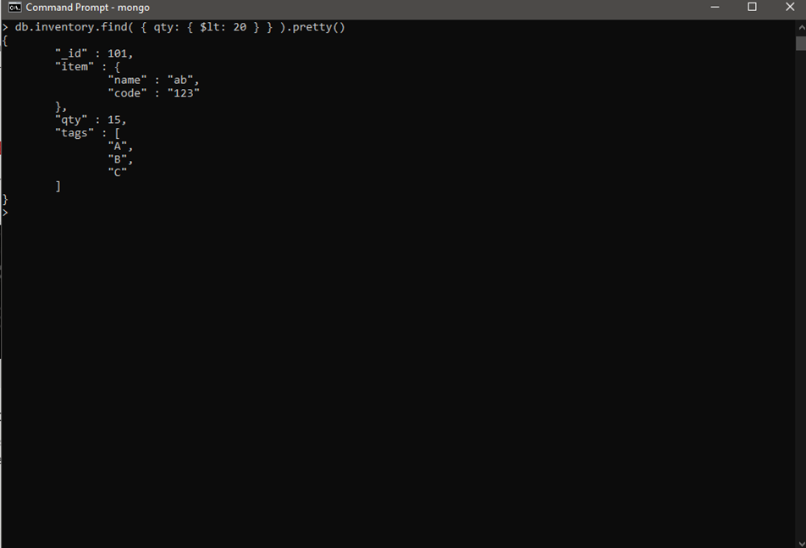
$lt operator

Slide 6
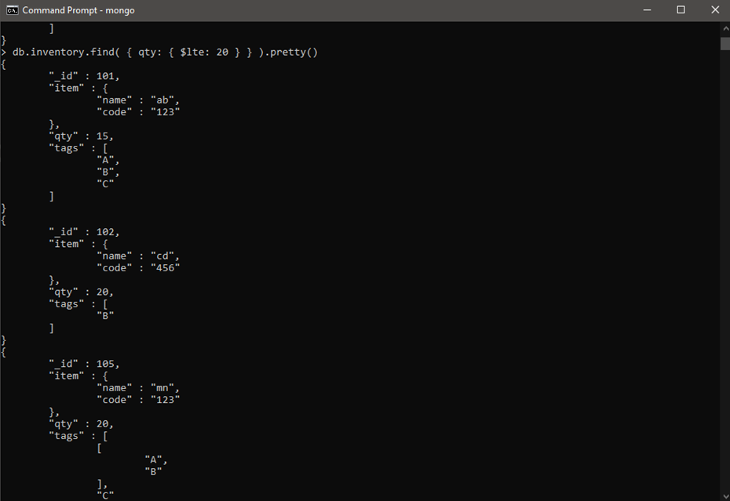
$lte opertor

Slide 7
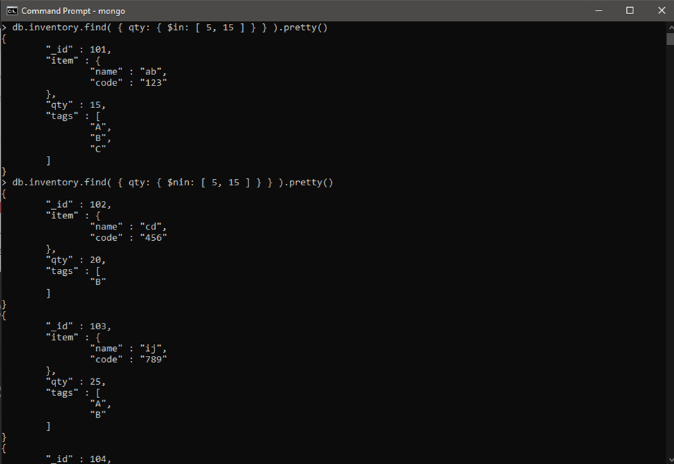
$in and $nin operators

